Slide 1
Schedule
Session 1. Selenium
Session 2. Selenium (Cont)
Session 3. Load Runner

Slide 2
Selenium

Slide 3
Content
Overview
Selenium IDE
Selenium WebDriver

Slide 4
I. Selenium - Overview
An open-source suite of tools that helps in automating only web applications.
Capable of operating across different browsers and operating systems.
Licensed under Apache License 2.0.

Slide 5
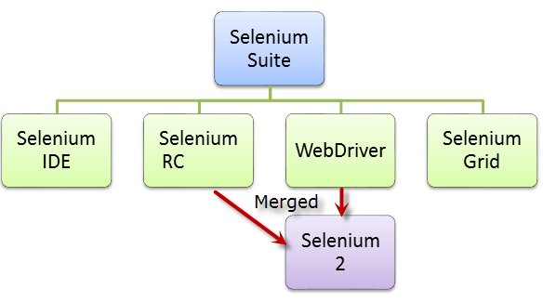
I. Selenium – Overview - Components
NOTE: Selenium 1 refers to Selenium RC.

Slide 6
I. Selenium – Overview – Components
Tool | Description
Selenium IDE | Selenium Integrated Development Environment (IDE) is a Firefox plugin that lets testers to record their actions as they follow the workflow that they need to test.
Selenium RC | Selenium Remote Control (RC) was the flagship testing framework that allows more than simple browser actions and linear execution. It makes use of the full power of programming languages such as Java, C#, PHP, Python, Ruby and PERL… to create more complex tests.
Selenium WebDriver | Selenium WebDriver is the successor to Selenium RC which sends commands directly to the browser and retrieves results.
Selenium Grid | Selenium Grid is a tool used to run parallel tests across different machines and different browsers simultaneously which results in minimized execution time.

Slide 7
II. Selenium – Selenium IDE
Selenium Integrated Development Environment (IDE) is the simplest framework in the Selenium suite and is the easiest one to learn.
It is a Firefox plugin that you can install as easily as you can with other plugins.
However, because of its simplicity, Selenium IDE should only be used as a prototyping tool. If you want to create more advanced test cases, you will need to use either Selenium RC or WebDriver.

Slide 8
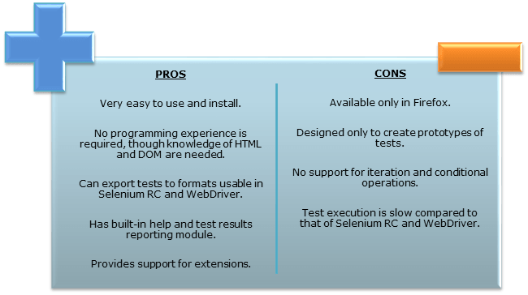
II. Selenium – Selenium IDE
Notes:
NOTE: the recorded scripts can be converted into various programming languages supported by Selenium and the scripts can be executed on other browsers as well.

Slide 9
II. Selenium – Selenium IDE – Get Started
Firefox 41.0.1 & Selenium 2.9.0

Slide 10
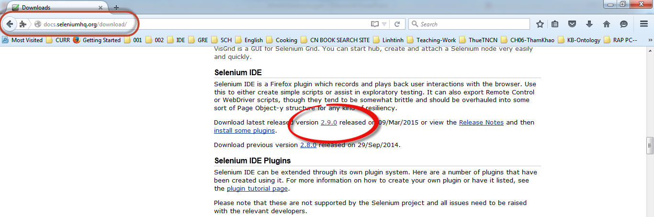
II. Selenium – Selenium IDE – Download

Slide 11
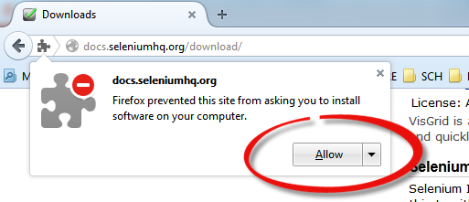
II. Selenium – Selenium IDE – Download

Slide 12
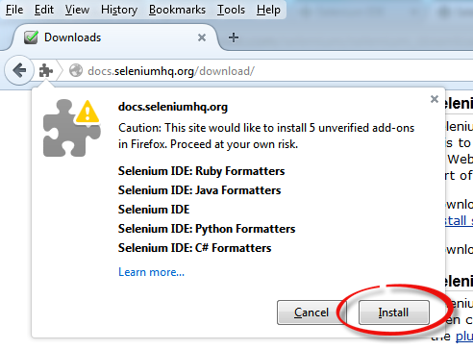
II. Selenium – Selenium IDE – Download & Configure

Slide 13
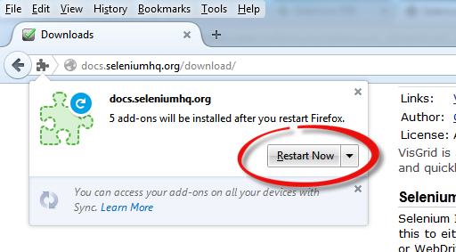
II. Selenium – Selenium IDE – Download

Slide 14
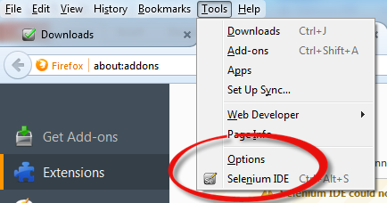
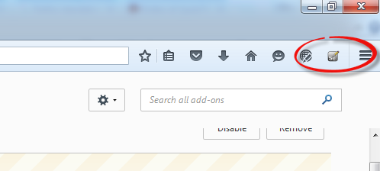
II. Selenium – Selenium IDE – Download

Slide 15
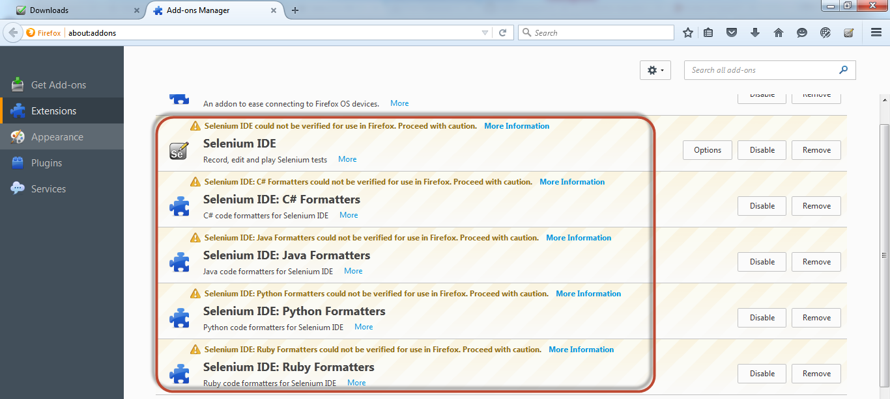
II. Selenium – Selenium IDE – Download

Slide 16
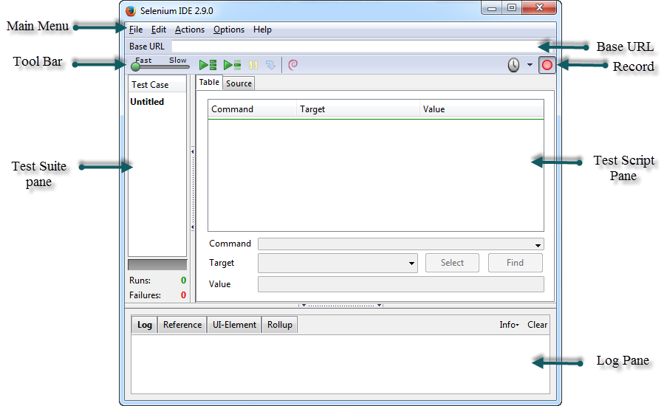
II. Selenium – Selenium IDE – Features

Slide 17
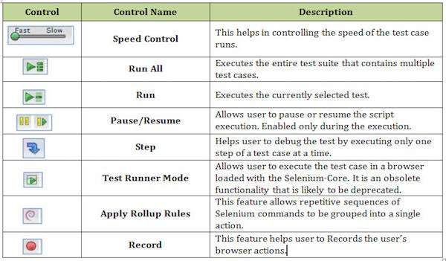
II. Selenium – Selenium IDE – Features

Slide 18
II. Selenium – Selenium IDE – Creating Selenium IDE Tests
Recording and adding commands in a test
Saving the recorded test
Saving the test suite
Executing the recorded test

Slide 19
II. Selenium – Selenium IDE - Recording and Adding Commands in a Test
We will use www.ncalculators.com to demonstrate the features of Selenium.
Step 1 : Launch the Firefox browser and navigate to the website - http://www.ncalculators.com/
Step 2 : Open Selenium IDE from the Tools menu and press the record button that is on the top-right corner.

Slide 20
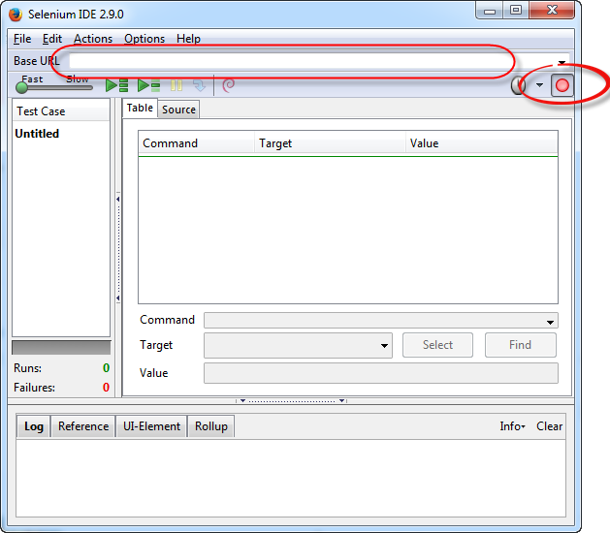
II. Selenium – Selenium IDE - Recording and Adding Commands in a Test

Slide 21
II. Selenium – Selenium IDE - Recording and Adding Commands in a Test
Step 3 : Navigate to “Math Calculator” >> “Number Conversion” >> “Percentage Calculator” >> enter “10” as number1 and 50 as number2 and click “Calculate”.

Slide 22
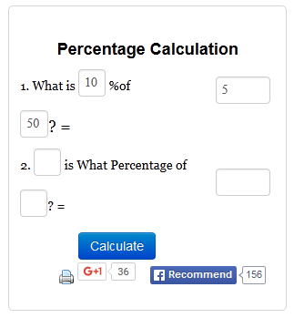
II. Selenium – Selenium IDE - Recording and Adding Commands in a Test

Slide 23
II. Selenium – Selenium IDE - Recording and Adding Commands in a Test
Step 4 : User can then insert a checkpoint by right clicking on the webelement and select "Show all available commands" >> select "assertValue id=result1 5"

Slide 24
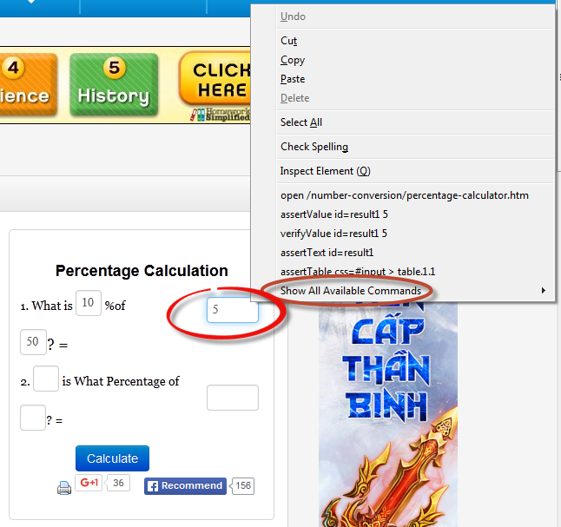
II. Selenium – Selenium IDE - Recording and Adding Commands in a Test

Slide 25
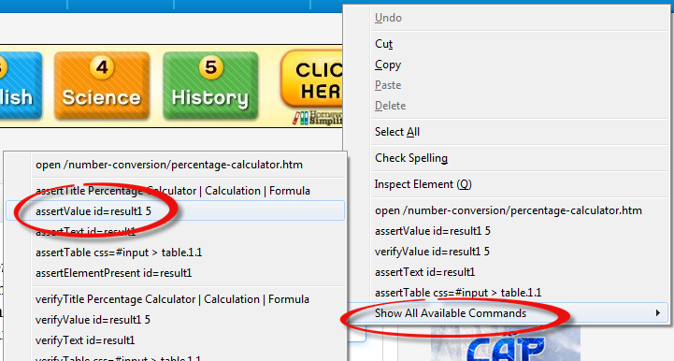
II. Selenium – Selenium IDE - Recording and Adding Commands in a Test

Slide 26
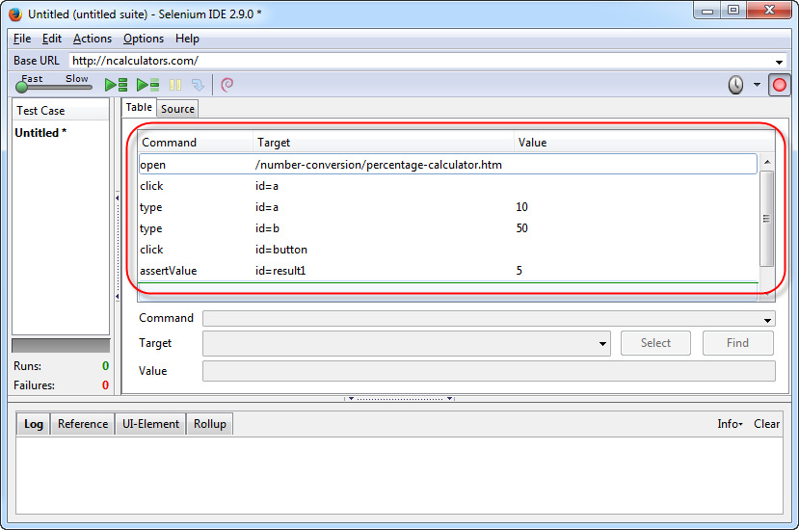
II. Selenium – Selenium IDE - Recording and Adding Commands in a Test

Slide 27
II. Selenium – Selenium IDE - Saving the Recorded Test
Save the Test Case by navigating to "File" >> "Save Test Case As" and save the file in the location of your choice. The file is saved as .HTML as default.
NOTE: The test can also be saved with an extension htm, shtml, and xhtml.

Slide 28
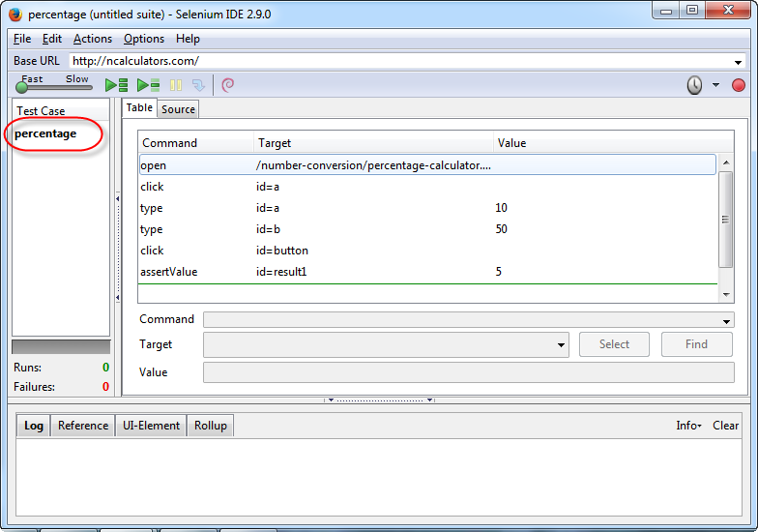
II. Selenium – Selenium IDE - Saving the Recorded Test

Slide 29
II. Selenium – Selenium IDE - Saving the Test Suite
A test suite is a collection of tests that can be executed as a single entity.
Step 1 : Create a test suite by navigating to "File" >> "New Test Suite" as shown below.
Or
Save a test suite with the current test case by navigating to "File" >> “SaveTest Suite As" as shown below.

Slide 30
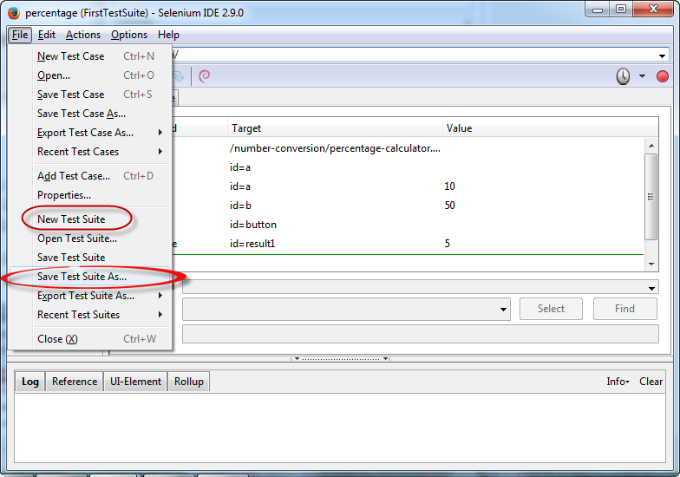
II. Selenium – Selenium IDE - Saving the Test Suite

Slide 31
II. Selenium – Selenium IDE - Saving the Recorded Test
Step 2 : The tests can be recorded one by one by choosing the option "New Test Case" from the "File" Menu.

Slide 32
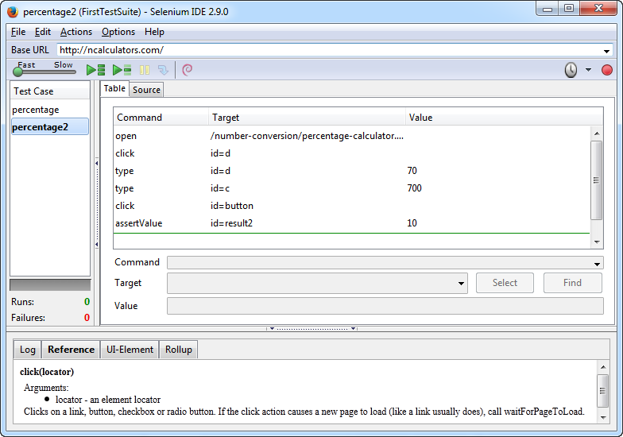
II. Selenium – Selenium IDE - Saving the Recorded Test

Slide 33
II. Selenium – Selenium IDE - Executing the Recorded Test
The recorded scripts can then be executed either by clicking "Play entire suite" or "Play current test" button in the toolbar.
Step 1 : The Run status can be seen in the status pane that displays the number of tests passed and failed.
Step 2 : Once a step is executed, the user can see the result in the "Log" Pane.
Step 3 : After executing each step, the background of the test step turns "Green" if passed and "Red" if failed as shown below.

Slide 34
II. Selenium – Selenium IDE - Executing the Recorded Test
The recorded scripts can then be executed either by clicking "Play entire suite" or "Play current test" button in the toolbar.
Step 1 : The Run status can be seen in the status pane that displays the number of tests passed and failed.
Step 2 : Once a step is executed, the user can see the result in the "Log" Pane.
Step 3 : After executing each step, the background of the test step turns "Green" if passed and "Red" if failed as shown below.

Slide 35
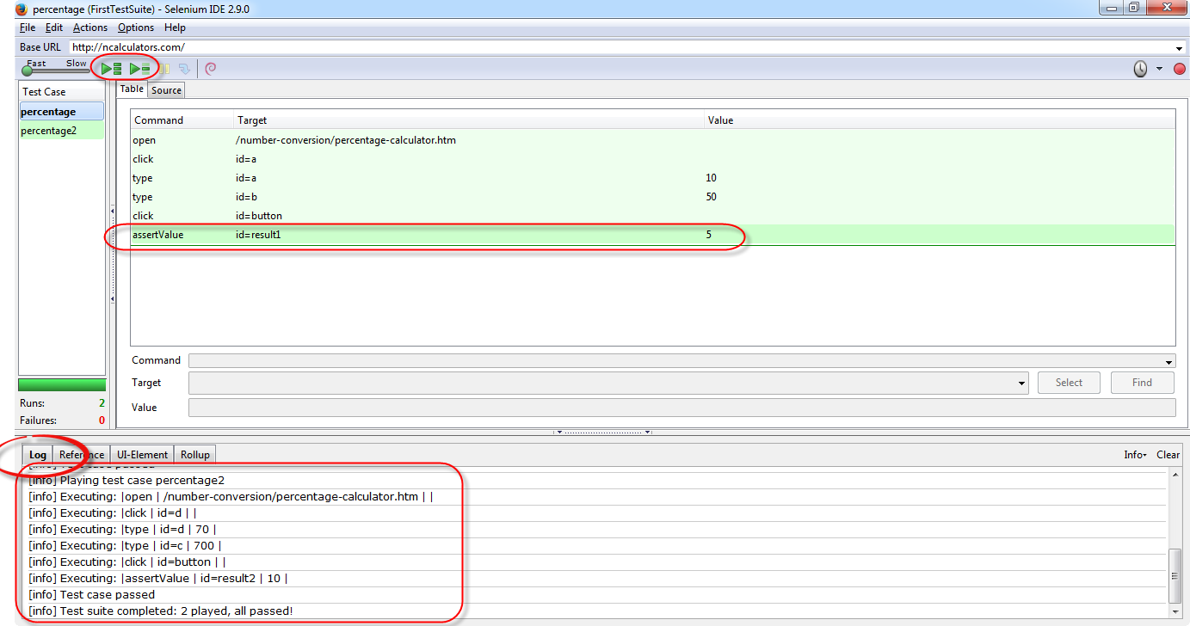
II. Selenium – Selenium IDE - Executing the Recorded Test

Slide 36
BUT … WAIT …!!!

Slide 37
Selenese Commands
Selenese Command: A command refers to what Selenium has to do.
Selenese commands can have up to a maximum of two parameters: target and value.
Parameters are not required all the time. It depends on how many the command will need.
Are of three types:
Actions
Accessors
Assertions

Slide 38
Selenese Commands - Action
These are commands that directly interact with page elements.
Example: the "click" command is an action because you directly interact with the element you are clicking at.
The "type" command is also an action because you are putting values into a text box, and the text box shows them to you in return. There is a two-way interaction between you and the text box.

Slide 39
Selenese Commands - Accessors
They are commands that allow you to store values to a variable.
Example: the "storeTitle" command is an accessor because it only "reads" the page title and saves it in a variable. It does not interact with any element on the page.

Slide 40
Selenese Commands - Assertions
Commands that verify if a certain condition is met.
3 Types of Assertions
Assert. When an "assert" command fails, the test is stopped immediately.
Verify. When a "verify" command fails, Selenium IDE logs this failure and continues with the test execution.
WaitFor. Before proceeding to the next command, "waitFor" commands will first wait for a certain condition to become true.
If the condition becomes true within the waiting period, the step passes.
If the condition does not become true, the step fails. Failure is logged, and test execution proceeds to the next command.
By default, the timeout value is set to 30 seconds. You can change this in the Selenium IDE Options dialog under the General tab.

Slide 41
Excercises:
1. Selenium IDE Script Debugging
2. Locators and How to use Locators in Selenium IDE.
3.1. Enhancing a script using Selenium IDE: Take a closer look at commands that will make your automation script more intelligent and complete.
3.2. Inserting Verification Points.
4. Selenium Pattern Matching.
5. Selenium User Extensions.

